Slide 1
Classification analysis for indian liver patient
By,
Name : mohammed sahil mh
usn : 1ms16is040

Slide 2
Indian liver patient dataset
About this Dataset
Data Set Information
This data set contains 416 liver patient records and 167 non liver patient records.The data set was collected from test samples in North East of Andhra Pradesh, India. 'is_patient' is a class label used to divide into groups(liver patient or not). This data set contains 441 male patient records and 142 female patient records. Any patient whose age exceeded 89 is listed as being of age "90".

Slide 3
Attribute Information
age Age of the patient
gender Gender of the patient
*tot_bilirubin* Total Bilirubin
*direct_bilirubin* Direct Bilirubin
alkphos Alkaline Phosphotase
sgpt Alamine Aminotransferase
sgot Aspartate Aminotransferase
*tot_proteins* Total Protiens
albumin Albumin
*ag_ratio* Albumin and Globulin Ratio
is_patient Selector field used to split the data into two sets (labeled by the experts)
Acknowledgements
The data set has been elicit from UCI Machine Learning Repository. My sincere thanks to them.

Slide 4
classification :
Classification can be performed on structured or unstructured data. Classification is a technique where we categorize data into a given number of classes. The main goal of a classification problem is to identify the category/class to which a new data will fall under.
Classifier: An algorithm that maps the input data to a specific category.
Classification model: A classification model tries to draw some conclusion from the input values given for training. It will predict the class labels/categories for the new data.

Slide 5
Classification Algorithms Used For This Problem
Logistic Regression
Naïve Bayes
K-Nearest Neighbours
Decision Tree
Random Forest

Slide 6
Step by Step approach for this problem
Importing the dataset.
Encoding the target feature as factor.
Splitting the dataset into the Training set and Test set. library(caTools)
Feature Scaling.
dimension reduction:In this problem Apply kernal PCA cuz its non linear problem.
Fitting classifier to the Training set and Create the classifier.

Slide 7
Logistic regression
Logistic regression is a machine learning algorithm for classification. In this algorithm, the probabilities describing the possible outcomes of a single trial are modelled using a logistic function.
classifier = glm(formula = is_patient ~ ., family = binomial,
data = training_set_pca)

Slide 8
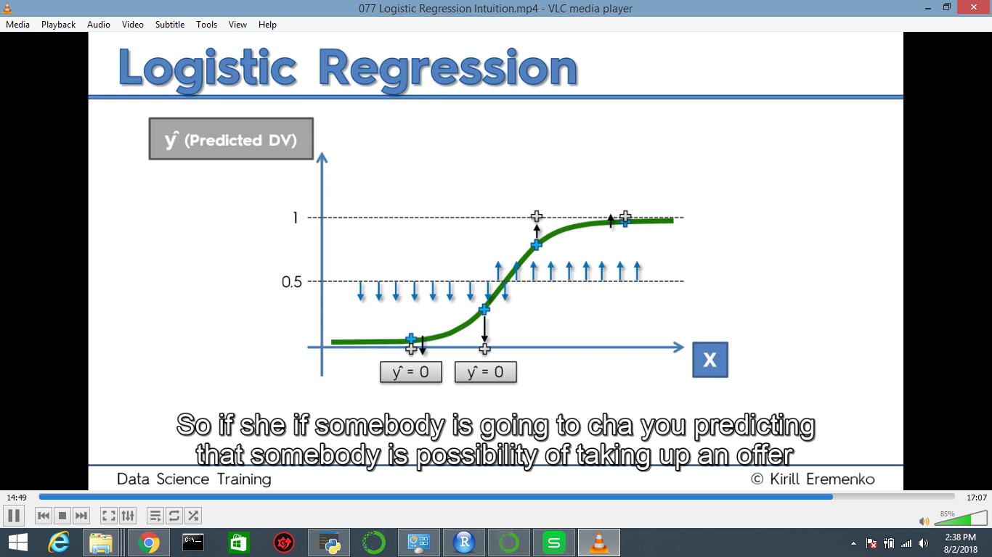

Slide 9
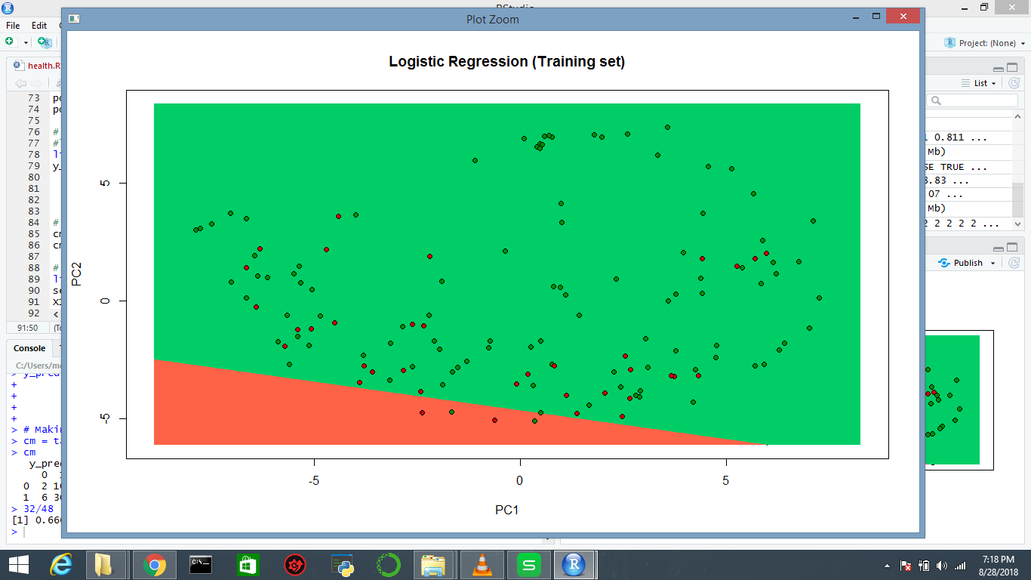
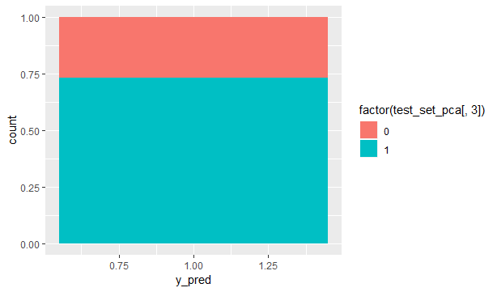
graph and accuracy for logistic regression
accuracy is 0.653 i,e 65%

Slide 10
KNN
Neighbours based classification is a type of lazy learning as it does not attempt to construct a general internal model, but simply stores instances of the training data. Classification is computed from a simple majority vote of the k nearest neighbours of each point
y_pred = knn(train = training_set_pca[, -3],
test = test_set_pca[, -3],
cl = training_set_pca[, 3],
k = 5,
prob = TRUE)

Slide 11
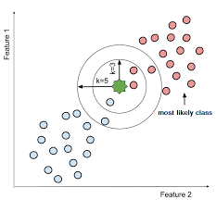

Slide 12
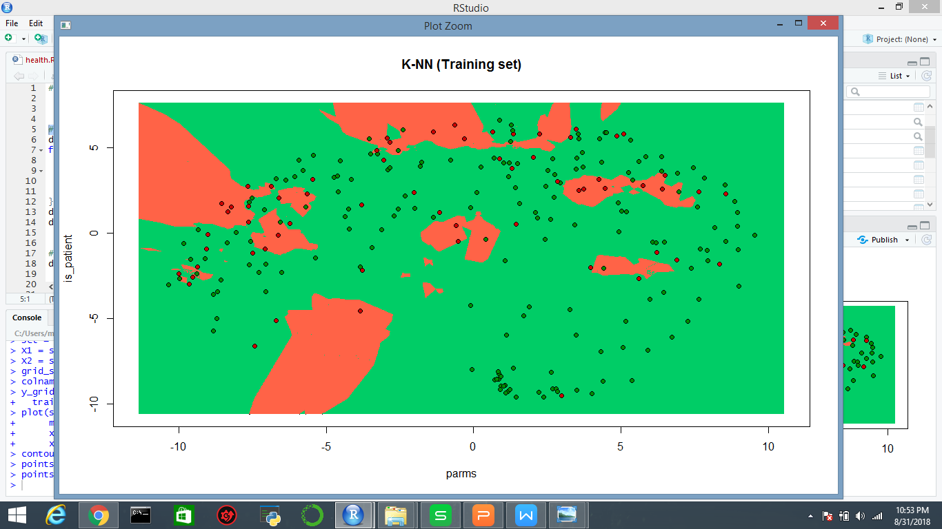
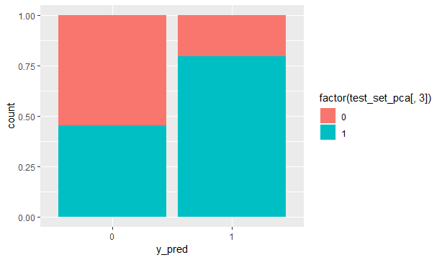
graph and accuracy: accuracy is 0.733 ~ 73%

Slide 13
Naive bayes
Naive Bayes algorithm based on Bayes’ theorem with the assumption of independence between every pair of features. Naive Bayes classifiers work well in many real-world situations such as document classification and spam filtering.
classifier = naiveBayes(x = training_set_pca[-3],
y = training_set_pca$is_patient)

Slide 14
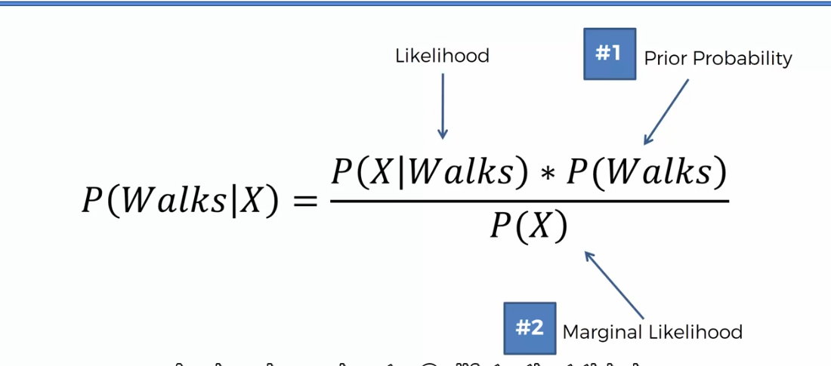
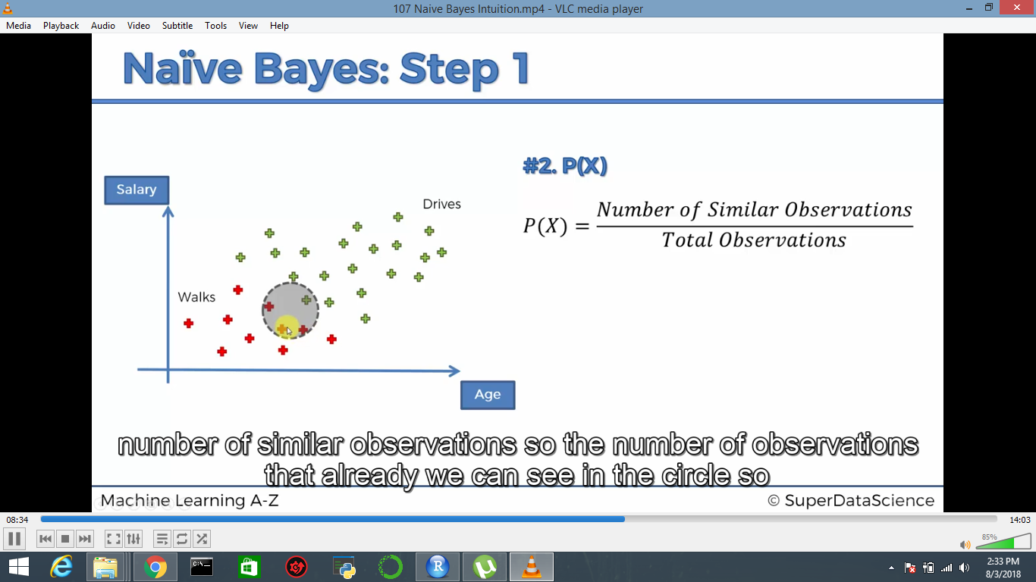
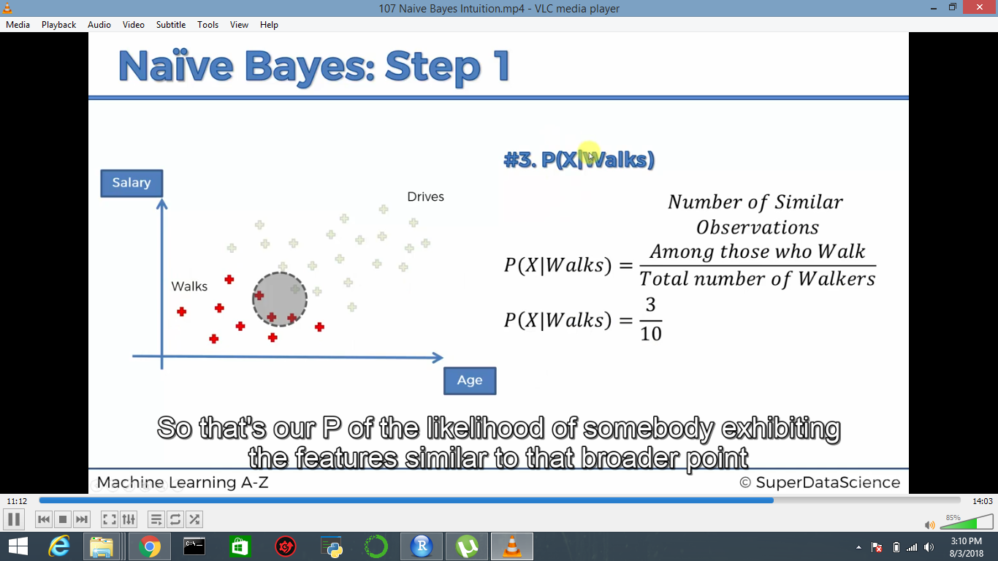
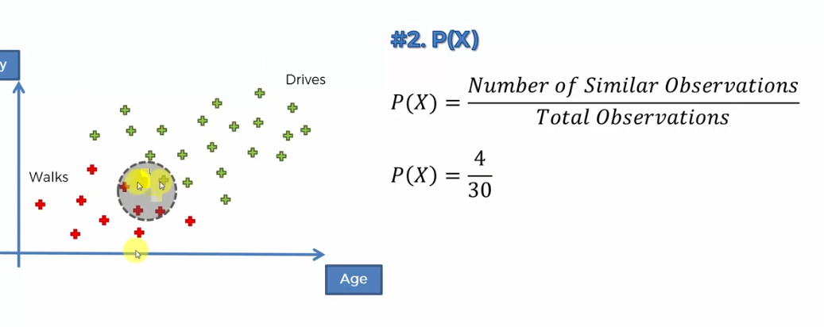

Slide 15
Decision tree
Given a data of attributes together with its classes, a decision tree produces a sequence of rules that can be used to classify the data.
library(rpart)
classifier = rpart(formula = is_patient ~ .,
data = training_set_pca)

Slide 16
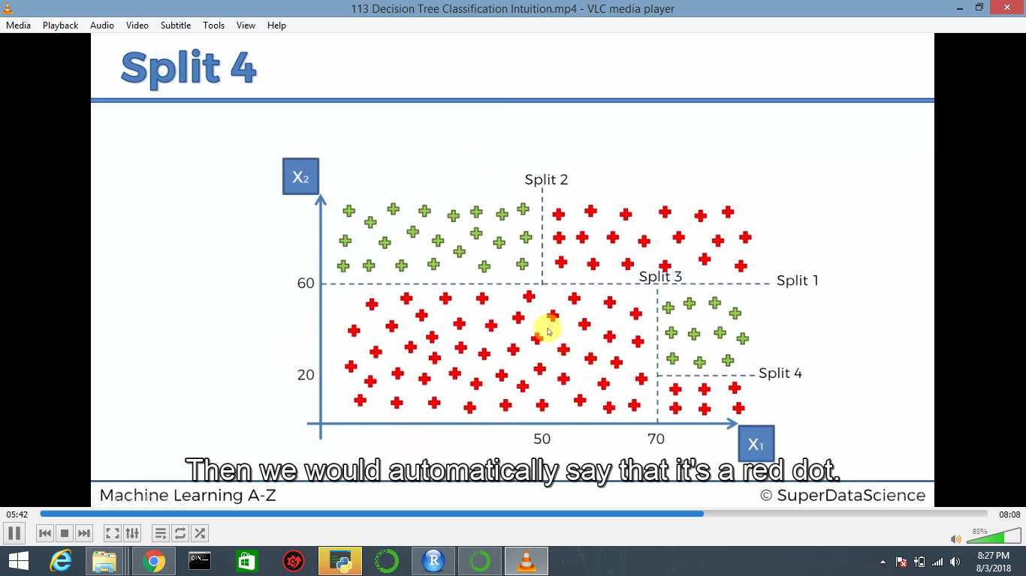

Slide 17
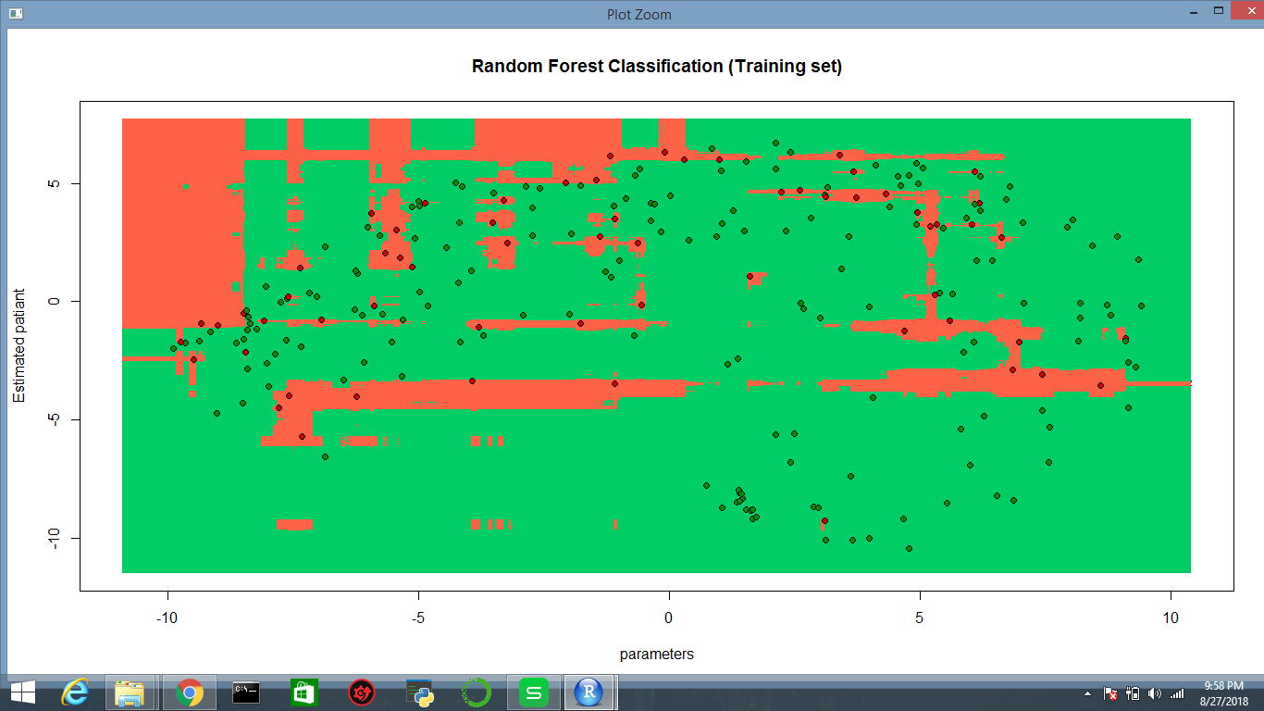
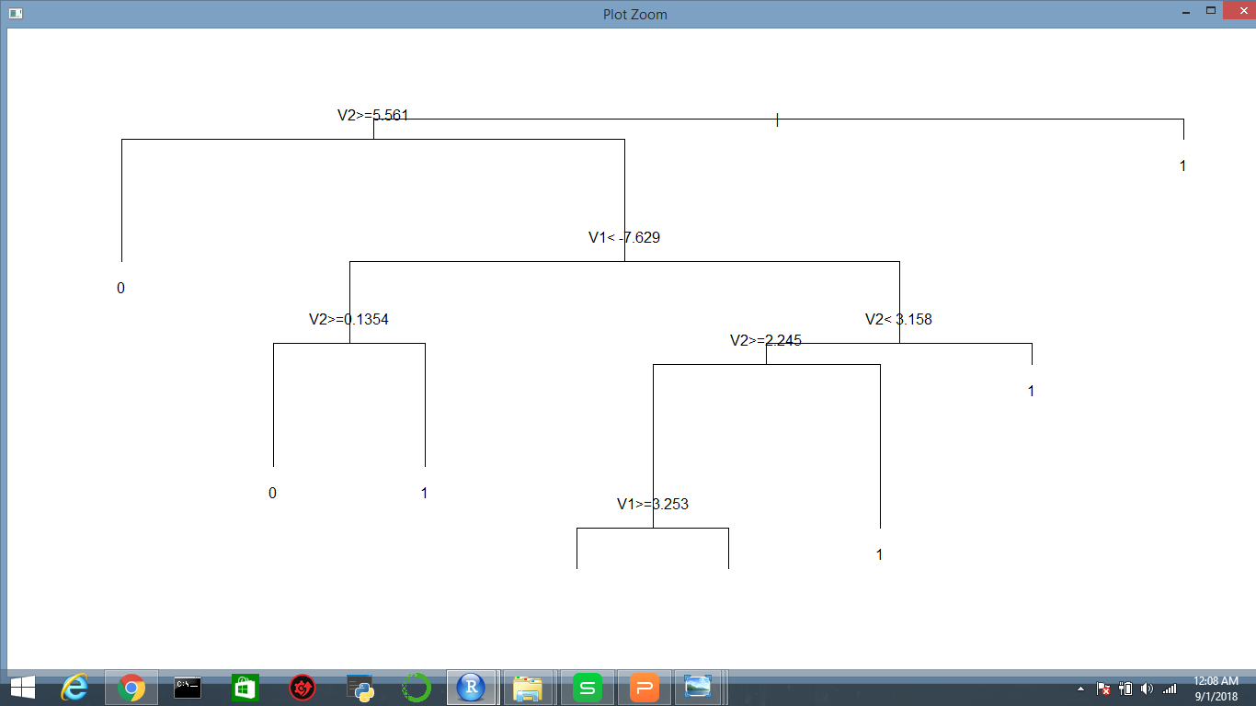
graph and accuracy 0.7~70%

Slide 18
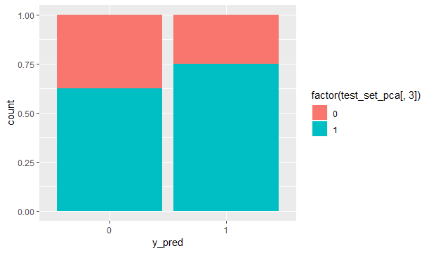

Slide 19
Random forest
Random forest classifier is a meta-estimator that fits a number of decision trees on various sub-samples of datasets and uses average to improve the predictive accuracy of the model and controls over-fitting. The sub-sample size is always the same as the original input sample size but the samples are drawn with replacement.
classifier = randomForest(x = training_set_pca[-3],
y = training_set_pca$is_patient,
ntree = 1000)

Slide 20
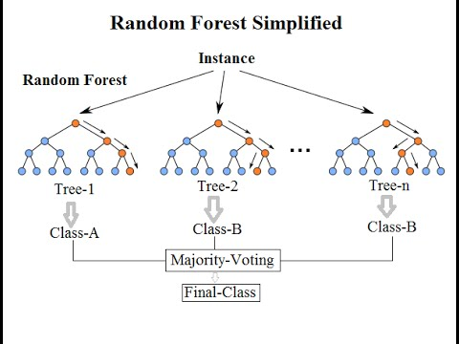
same as decision tree but it has N number of decision tree is random forest

Slide 21
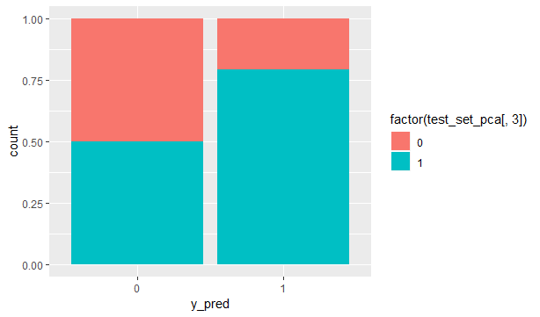
graph and accuray 0.733~73%

Slide 22
conculsion
Scince the knn and random forest are of accuracy 73%
Both models are good to go by using dimension reduction.(kernel pca)

